Slide 1
Dec 2, 2016 Status review
Project Name:
Equifax: Sharing LSS Projects
Sponsor:
Jay Runner
Team Members:
Ameya Jamgade, Archana Kadambi, Athira Sudhakaran, Ilia Prokashev, Parag Dhameja, Sagar Jain
Current Status:
Verify Phase

Slide 2
Define Phase: Project Charter
Problem Statement: Equifax lacks a standardized process to document completed/ongoing Lean Six Sigma (LSS) projects and to share improvement opportunities with other Functions and Business Units (BU). Lack of this process leads to potential duplication of work and lost opportunities for cost savings.
Goal: Work on the documentation process that can facilitate reuse of completed/ongoing projects across Functions and Business Units.
Primary Metric: Percentage of projects successfully compiled/condensed into a medium that can be used by other BUs and Functions across Equifax.
Secondary Metrics: Number of LSS projects actually re-used by other BUs and Functions.
Scope: All Equifax processes
Process Boundaries: Start of a LSS project until completion and implementation across all BUs and Functions
Other relevant information:
Team Members: PMO, Green Belts in each Business Unit, Functional team members – IT, Security. Legal.

Slide 3
Measure Phase: SIPOC
Suppliers | Inputs | Process | Outputs | Customers
Business Unit POC. Functional teams (IT,PMO). Green Belts who completed LSS projects. SMEs | Project Executive Summaries. Insights from SMEs. SharePoint and other tools. | Consolidate projects in a standard method. Classify projects for easy filtration. | A system which encourages reusability of projects across teams. Percentage of projects successfully compiled/condensed into a medium. Number of LSS projects actually re-used. | Business Unit POC. Functional teams (IT,PMO). Green Belts who completed LSS projects. SMEs

Slide 4
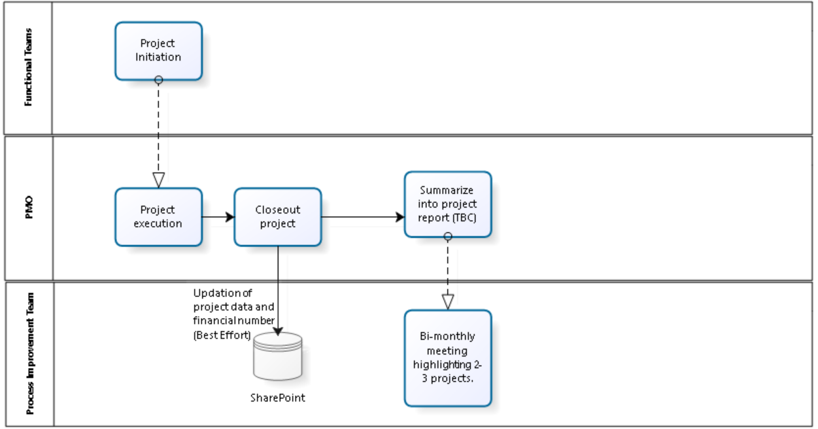
Measure Phase: As-is Process Map/Value Stream Map

Slide 5
Measure Phase: Tools / Activities – Survey to Greenbelts and Leadership
“What is the best knowledge sharing practice in the company right now?” – Process not defined
“Do you discuss improvements with other departments on implementation stage? If you do what is the stage in the project where you discuss improvements with the other departments?” – Lack of standard communication
“Do you think that Equifax has adequate workforce resources to implement and provide consistent support this project?” – Lack of workforce
Notes:
VOC: Survey, Requirements, Expectations
Run Chart
MSA
Validate baseline metric
Pareto Charts
Spaghetti Diagram
5S
8 Forms of waste
Fishbone
Deliverables from Measure Phase:
Lean Improvements
“Possible causes”

Slide 6
Measure Phase: Tools / Activities – Fishbone Analysis
Lack of robust technology.
No clarity on responsibility of process / system.
Legal boundaries might render some project not reusable.
Notes:
VOC: Survey, Requirements, Expectations
Run Chart
MSA
Validate baseline metric
Pareto Charts
Spaghetti Diagram
5S
8 Forms of waste
Fishbone
Deliverables from Measure Phase:
Lean Improvements
“Possible causes”

Slide 7
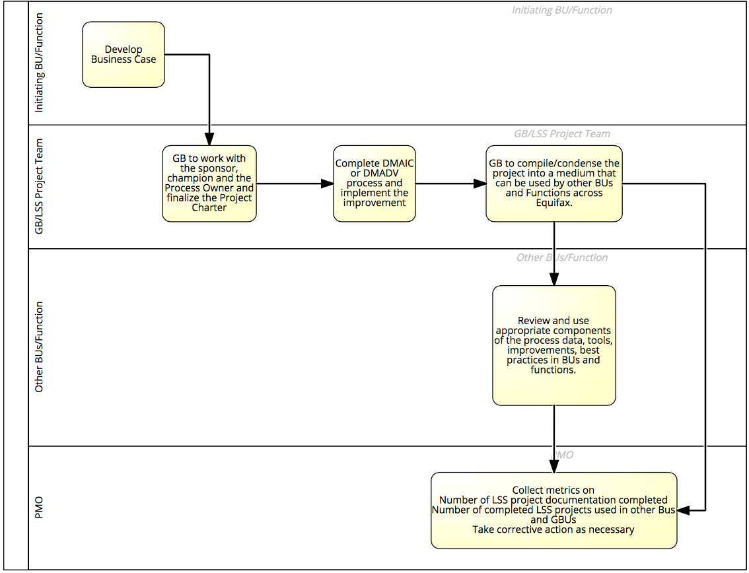
Measure Phase: Tools / Activities – To-Be Process
Notes:
VOC: Survey, Requirements, Expectations
Run Chart
MSA
Validate baseline metric
Pareto Charts
Spaghetti Diagram
5S
8 Forms of waste
Fishbone
Deliverables from Measure Phase:
Lean Improvements
“Possible causes”

Slide 8

Analyze phase : Identification of root causes
Lack of robust technology
Lack on motivation/ incentive
Legal boundaries
Lack of formal process guidelines
Lack of clarity on responsibilities

Slide 9
Improve phase: Potential solutions
Causes | Potential Solutions | Deliverables/Execution
Lack of robust technology. | Develop/Procure new system. | PlanView / Jira Sharepoint (existing) MS Excel + Shared drive
No clarity on responsibilities of future process/system. | Well defined responsibilities for all personnel. | Handbook (Document containing exhaustive list of individuals and respective responsibilities)
Lack of Motivation Incentives Consequences | Audit actions and usage of a Metrics based system | Use of Metrics Employee appreciation Program Audit Actions
Legal Boundaries render some projects not reusable. | Identify as not reusable | N/A
Lack of formal guidelines (When?, How?, Why?) | Well documented process and team-wise documentation. | Handbook (Document)
Notes:
VOC: Survey, Requirements, Expectations
Run Chart
MSA
Validate baseline metric
Pareto Charts
Spaghetti Diagram
5S
8 Forms of waste
Fishbone
Deliverables from Measure Phase:
Lean Improvements
“Possible causes”

Slide 10
Potential systems
Jira – Confluence
Licensing cost : $24000 for up to 2000 users
Configuration and development : appx $10000
Training methods :
Instructor led (online) : $3000 - $4500 per team
Self paced learning
Sharepoint (Existing Solution)
MS Excel
Notes:
VOC: Survey, Requirements, Expectations
Run Chart
MSA
Validate baseline metric
Pareto Charts
Spaghetti Diagram
5S
8 Forms of waste
Fishbone
Deliverables from Measure Phase:
Lean Improvements
“Possible causes”

Slide 11
Analyze Phase: Process & Data Analysis/Tools/ Activities - FMEA
 |  |  |  |  | Occurrence
Process Function (Step) | Potential Failure Mode(s) | Potential Effect(s) of Failure | Sev | Potential Cause(s)/ Mechanism(s) of Failure
 |  |  |  |  |  | Current Process Controls | Det | RPN
Project Execution | Description information i.e. Metadata/Hashtags are too broad or too narrow in scope. | Failure in adequate lookup | 9 | Lack of guidelines | 9 | None | 8 | 648
Project Inititation | Clear KPIs/Deliverables have not been identified. | Inaccurate/incomplete information | 9 | Project process is deficient. | 5 | None | 8 | 360
Project Execution. | From the project artefacts being produced by each project, adequate information is not available. | Potential loss of information. | 8 | Project process is deficient. | 5 | None | 8 | 320
Functional Support | Technology platform (Sharepoint) may crash causing disruption to operations. | Loss of Data | 7 | Lack of Technology support | 5 | None | 8 | 280
Project Execution. | Accountability of updating information into Sharepoint is not clear. | Inaccurate/incomplete information | 7 | Project process is deficient. | 5 | None | 8 | 280
Notes:
Graphical analysis
Histograms
Box Plots
Hypothesis Tests
Proportions
Mean/Median
Regression/Correlation
Deliverable from Analyze Phase:
List of “critical Causes”

Slide 12
FMEA - Continued
Process Function (Step) | Potential Failure Mode(s) | Potential Effect(s) of Failure
 |  |  | RPN | Recommended Action(s) | Responsibility
Project Execution. | Description information i.e. Metadata/Hashtags are too broad or too narrow in scope. | Failure in adequate lookup | 648 | Green belts to define Metadata/Hashtags according to Equifax's business environment. | Green Belts (BUs)
Project Inititation | Clear KPIs/Deliverables have not been identified. | Inaccurate/incomplete information | 360 | Overall Management Responsibility | Equifax Management
Project Execution. | From the project artefacts being produced by each project, adequate information is not available. | Potential loss of information. | 320 | Perform audit of process | Internal Audit Team
Functional Support | Technology platform (Sharepoint) may crash causing disruption to operations. | Loss of Data | 280 | Replace/Update existing technology with new system (cloud) | Jay Runner/ Susan Armstrong
Project Execution. | Accountability of updating information into Sharepoint is not clear. | Inaccurate/incomplete information | 280 | Handbook (Document containing exhaustive list of individuals and respective accountability) | Jay Runner
Notes:
Graphical analysis
Histograms
Box Plots
Hypothesis Tests
Proportions
Mean/Median
Regression/Correlation
Deliverable from Analyze Phase:
List of “critical Causes”

Slide 13
Next Steps in the DMADV Process
Verify Phase January 2017
Select and implement new process solutions
Monitor and continuously improve the process
Metrics used to monitor the process:
Percentage of projects successfully compiled/condensed into a medium that can be used by other BUs and Functions across Equifax.
Number of LSS projects actually re-used by other BUs and Functions.

Slide 14
Lessons Learned: Related to the DMAIC/DMADV Process, Team Dynamics
What went well?
Able to experience a ‘real life’ application of DMADV- a process not a lot of LSS practitioners get to do…
Great flexibility in working within the confines of data limitations (laptop availability)
What could be improved?
3-locations and competing schedules made meeting difficult; we needed to meet more frequently
Difficult subject to tackle- probably not the best ‘learning’ topic
Needed better defined tollgates and expectation management (probably fixed if we met more frequently)

Slide 15

Questions?

